Slide 1


TERM PROJECT –Group 7
Students:
Albin Babu Varghese
Ali Guneysel
Erinda Kapllani
Jai Vigneshwar Aiyyappan
Kaushal Ghelani
Kumud
Madhoumithaa Veerasethu
Rajvi Patel
Attrition Prediction
SCHOOL OF COMPUTER TECHNOLOGY
AASD 4001 Mathematical Concepts for Machine Learning

Slide 2
INTRODUCTION
DATASET: EMPLOYEE DATA
https://www.kaggle.com/datasets/tawfikelmetwally/employee-dataset
Context:
This dataset encompasses data concerning company employees, encompassing their educational records, employment histories, demographic profiles, and various factors related to their jobs.
Columns/features:
Education: The educational qualifications of employees, including degree, institution, and field of study.
Joining Year: The year each employee joined the company, indicating their length of service.
City: The location or city where each employee is based or works.
Payment Tier: Categorization of employees into different salary tiers.
Age: The age of each employee, providing demographic insights.
Gender: Gender identity of employees, promoting diversity analysis.
Ever Benched: Indicates if an employee has ever been temporarily without assigned work.
Experience in Current Domain: The number of years of experience employees have in their current field.
Leave or Not: Whether they left the company or not
Target Ratio: 66% Not Resigned : 34% Resigned

Slide 3
PROBlem STATEMENT
DATASET: EMPLOYEE DATA
https://www.kaggle.com/datasets/tawfikelmetwally/employee-dataset
Objective:
The primary objectives are as follows:
Attrition Prediction: Develop a predictive model to identify employees at risk of leaving the company.
Understanding Drivers: Determine the key factors contributing to employee attrition.
Approach: We will employ various data analysis techniques and machine learning algorithms in Python to address the objectives and challenges mentioned above. Libraries like Pandas, Scikit-Learn, Matplotlib, and Seaborn will be used for data preprocessing, analysis, modeling, and visualization.
Expected Outcomes: We aim to provide a predictive model for identifying potential employee attrition risks, insights into attrition drivers, and tailored retention strategies to reduce attrition rates.

Slide 4
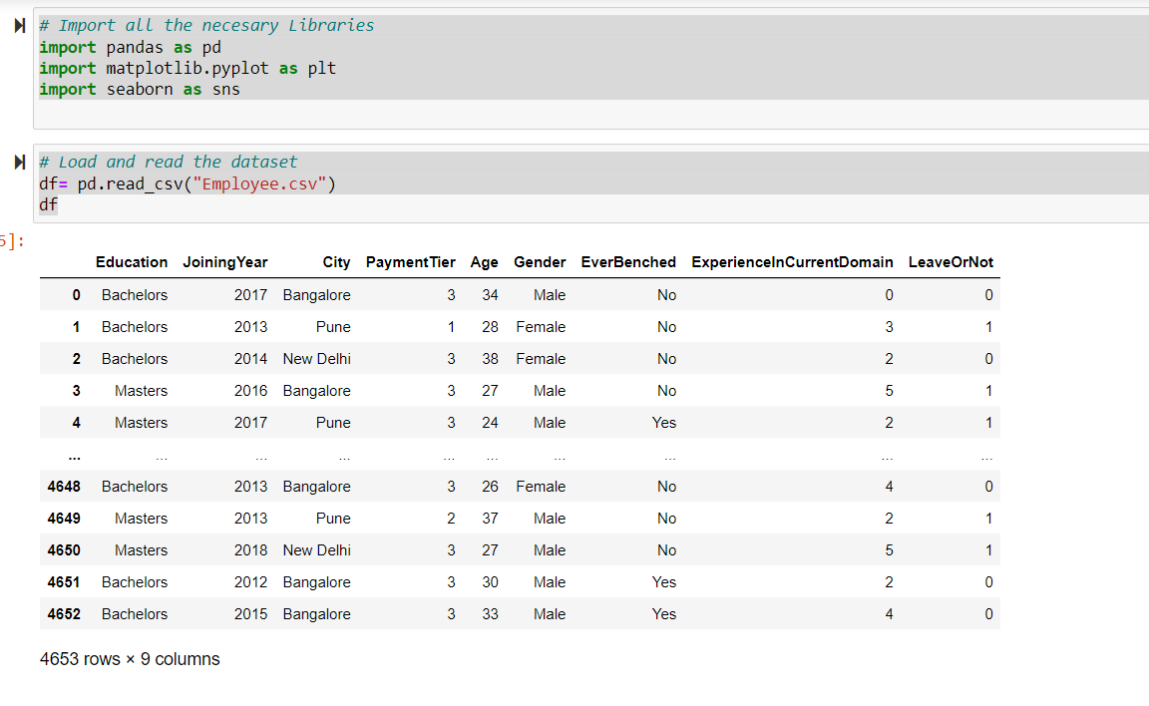
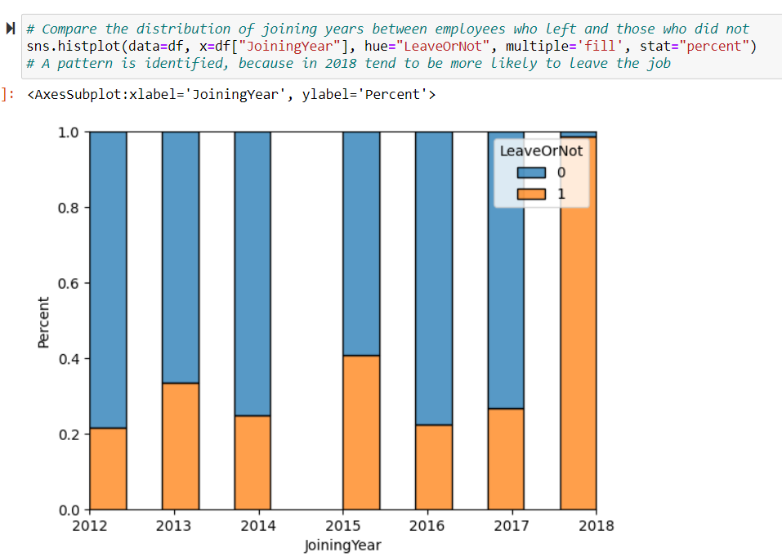
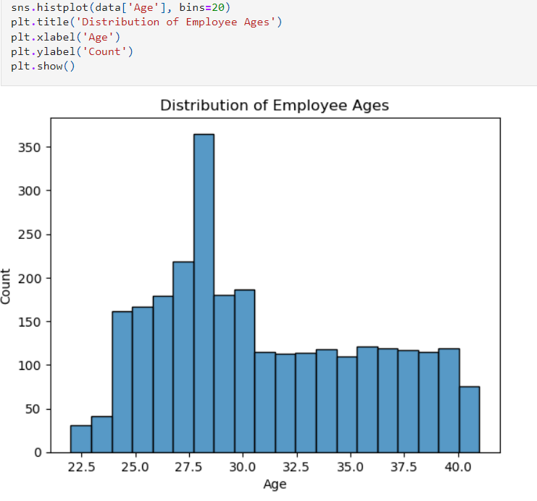
Exploratory Data Analysis (EDA)
Data Quality:
The dataset consists of 4,653 rows and 9 columns.
There are no missing values in any of the columns.
Summary Statistics: Summary statistics were calculated for numeric variables: JoiningYear, PaymentTier, Age,ExperienceInCurrentDomain, & LeaveOrNot.
Data Visualization:
Histograms
Bar plots
Key Observations
(1) In fig2. there is a pattern for employees who joined in 2018.
Pairwise scatter
Box plots
Cross-tabulation (contingency table)
(2) The age distribution shows differences between employees who left and those who did not.
Fig1. Display data of dataset
Fig2. Bar Chart that shows the distribution Joining Years among employess who left or not
Fig3. Histogram: Distribution of Employees Age

Slide 5
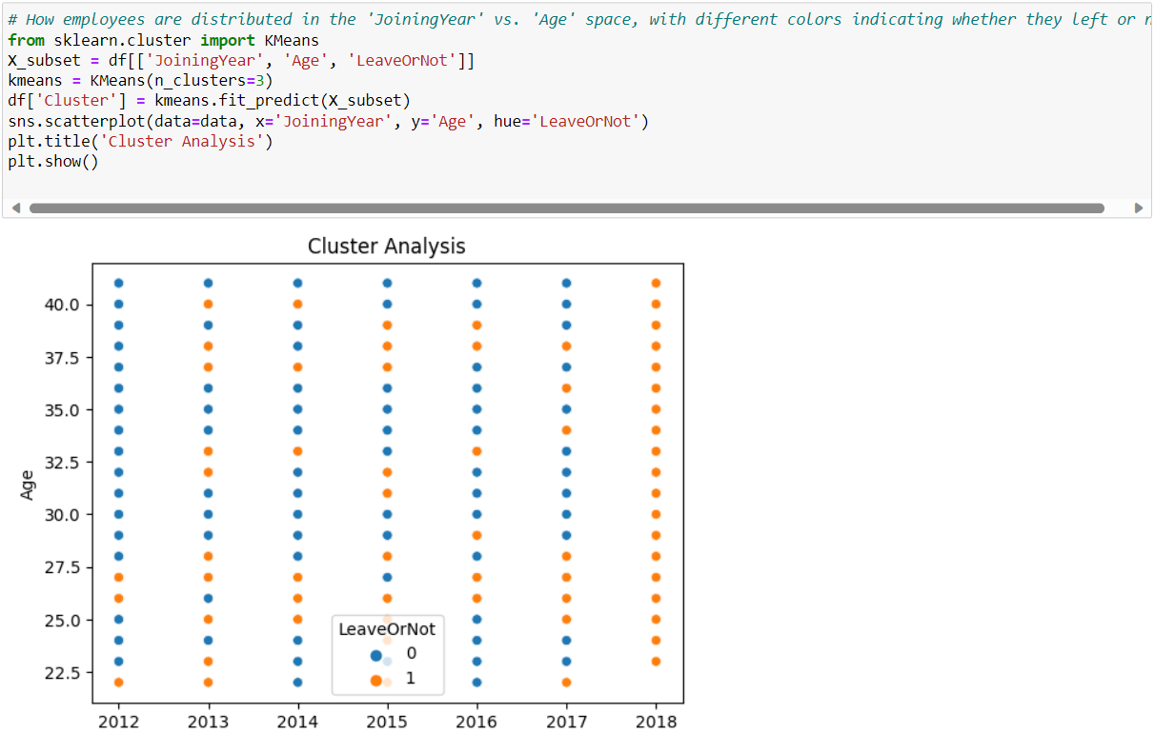
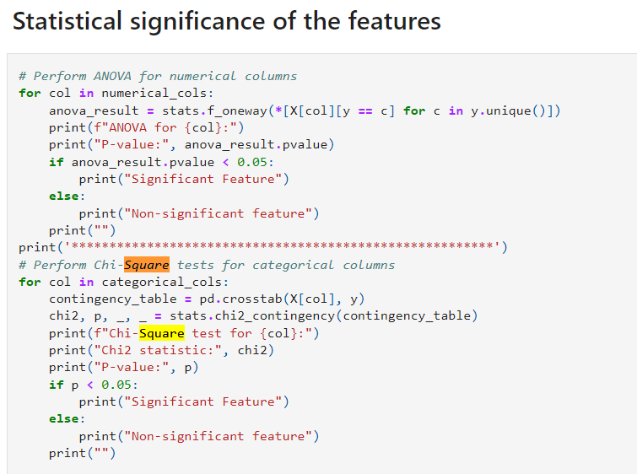
Exploratory Data Analysis (EDA)
Chi-Square Test:
For Education:
Chi2 statistic: 101.83014138498626
P-value: 7.724417739147332e-23
Significant Feature
For City:
Chi2 statistic: 206.15885400194648
P-value: 1.7106992135618012e-45
Significant Feature
For Gender:
Chi2 statistic: 225.6953561969211
P-value: 5.177873883438753e-51
Significant Feature
For EverBenched:
Chi2 statistic: 28.086147926708364
P-value: 1.1603340647939294e-07
Significant Feature
ANOVA Test:
ANOVA for JoiningYear:
P-value: 7.901616664702911e-36
Significant Feature
ANOVA for PaymentTier:
P-value: 3.384266876818402e-42
Significant Feature
ANOVA for Age:
P-value: 0.0004852123420637579
Significant Feature
ANOVA for ExperienceInCurrentDomain:
P-value: 0.03746138354036463
Significant Feature
Fig4. Dot Plot: Employees distribution in the Joining Year vs Age space, related to Leave Or Not Leave field
Fig5. Anova and Chi-Square testing

Slide 6
Pre-process & transforming data
Data Preprocessing with Transformers
Data Splitting
Creating a Full Pipeline
Transforming Data
Definition of a Metrics Calculation Function
Numerical_transformer
Categorical_transformer
Used train_test_split
Used for training: 80% of data
Used for testing: 20% of data
A full pipeline is defined using the Pipeline class
It only includes the preprocessing step (the ‘preprocessor’ defined
The training data is transformed and stored in ‘X_train_scaled’
The testing data in ‘X_test_scaled’
‘metrics calculation’: calculates classification metrics: Precision, Recall, AUC (Area Under the Curve), F1 Score, and Accuracy

Slide 7
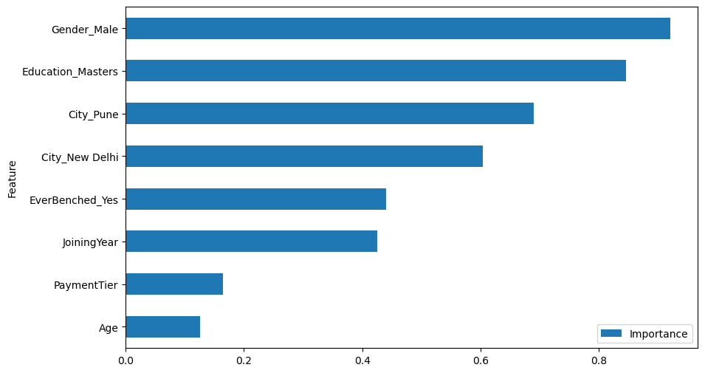
Logistic regression
Baseline Logistic Regression Model:
Grid Search for Hyperparameter Tuning:
Re-training the Model with Best Hyperparameters:
Feature Importance:
Feature Selection:
Grid Search with Reduced Features:
Re-training the Model with Best Hyperparameters (Reduced Features):
Evaluation and Metrics (Reduced Features):
Metrics:
Precision: 0.684729
Recall: 0.434375
AUC: 0.6648143
F1 Score: 0.53154875
Accuracy: 0.7368421
Fig6. Feature Importance
LogisticRegression(C=100, max_iter=1000, penalty='l1', solver='liblinear')

Slide 8
Decision tree
Baseline Decision Tree Model:
Grid Search for Hyperparameter Tuning:
Re-training the Model with Best Hyperparameters:
Feature Selection Based on Correlation:
Feature Selection Based on AUC:
Grid Search on Reduced Features:
Re-training the Model with Best Hyperparameters (Reduced Features):
Evaluation and Metrics (Reduced Features):
Metrics:
Precision: 0.85
Recall: 0.70
AUC: 0.82
F1 Score: 0.77
Accuracy: 0.85
DecisionTreeClassifier(criterion='entropy', max_depth=6, random_state=1234)

Slide 9
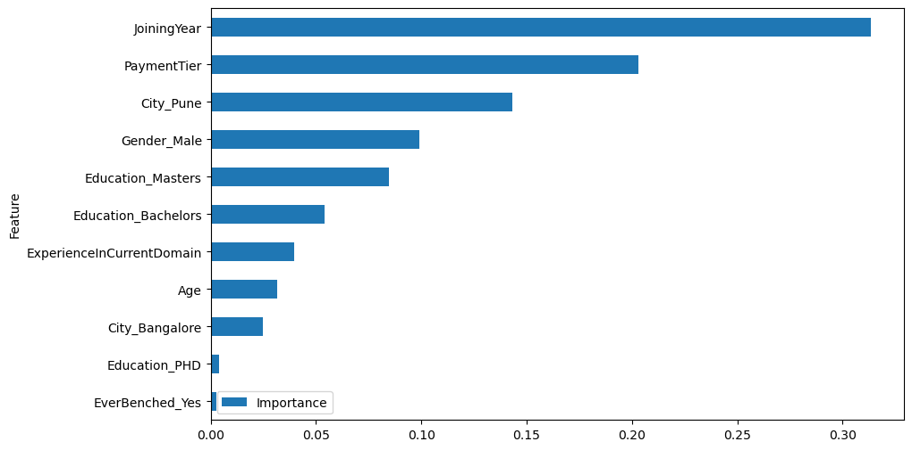
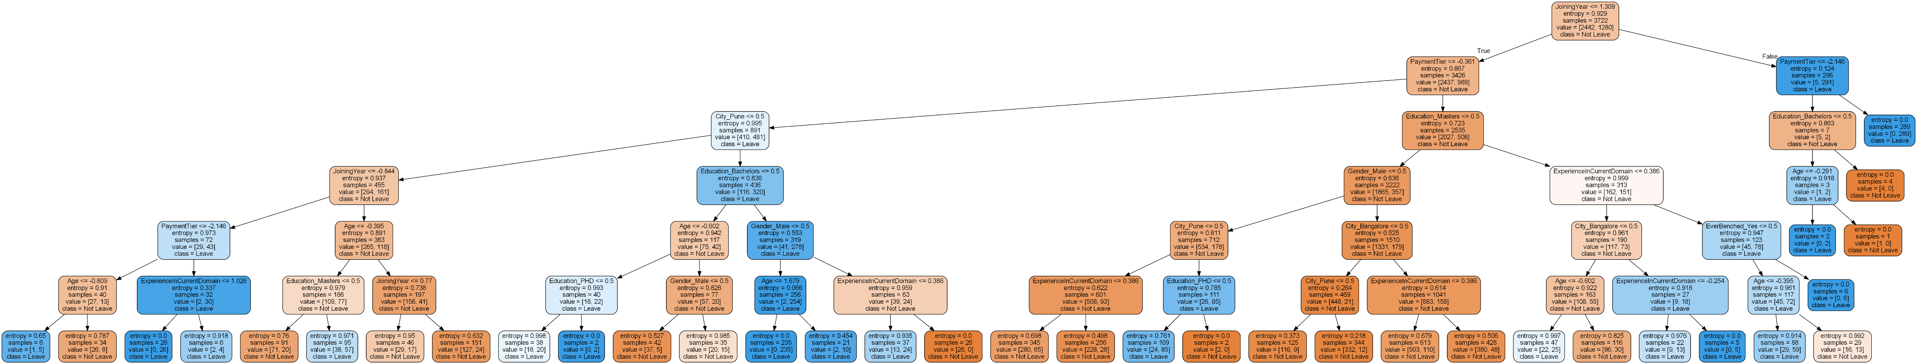
Decision tree
Fig7. Decision Tree Feature Importance
Fig8. Decision Tree2

Slide 10
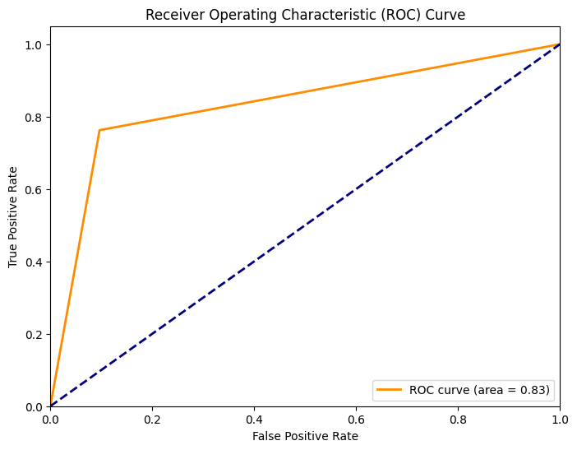
Support Vector Machines
Creating a Baseline SVM:
Plotting ROC Curve and AUC:
Model Predicted by GridSearchCV (All Features):
Using Correlation Matrix to Identify Features to Be Removed:
Removing Features Based on Correlation:
Model Predicted by GridSearchCV (Few Features Removed):
Final Model Predicted by GridSearchCV (All Features):
SVM{'C': 2, 'class_weight': 'balanced', 'gamma': 0.3, 'kernel': 'rbf'}
Metrics:
Precision: 0.81
Recall: 0.76
AUC: 0.83
F1 Score: 0.78
Accuracy: 0.85
Fig9 Final Model predicted by GridSearchCV (features removed)

Slide 11
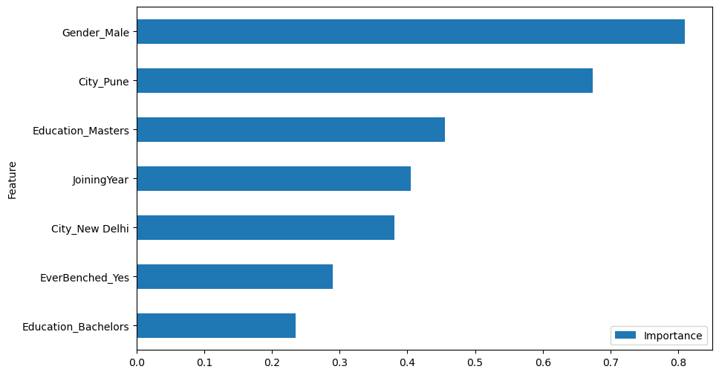
Stochastic Gradient Descent Classifier
Base Model:
GridSearch on All Features:
Feature Importance Analysis
Grid Search on Reduced Features:
Final SGD Model with all the features
SGD{'alpha': 0.01, 'loss': 'log_loss', 'max_iter': 500, 'penalty': 'l2', 'random_state': 42}
Metrics:
Precision: 0.63
Recall: 0.42
AUC: 0.64
F1 Score: 0.50
Accuracy: 0.72
Fig10. SGD

Slide 12
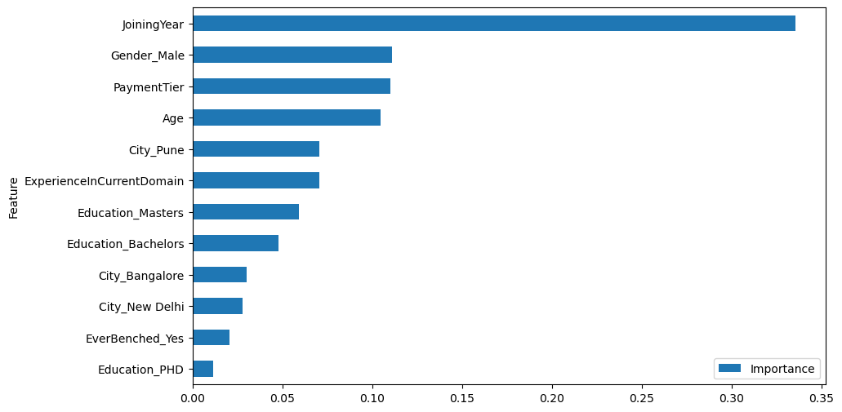
RANDOM FOREST
Baseline Model:
GridSearch on All Features:
Feature Importance Analysis:
Grid Search on Reduced Features:
Final Model for Random Forest:
Storing Model Performance in a DataFrame:
RandomForestClassifier(criterion='entropy', max_depth=10, max_features='auto', n_estimators=1000, random_state=1234)
Metrics:
Precision: 0.87
Recall: 0.70
AUC: 0.82
F1 Score: 0.78
Accuracy: 0.86
Fig12. Random Forest 2

Slide 13
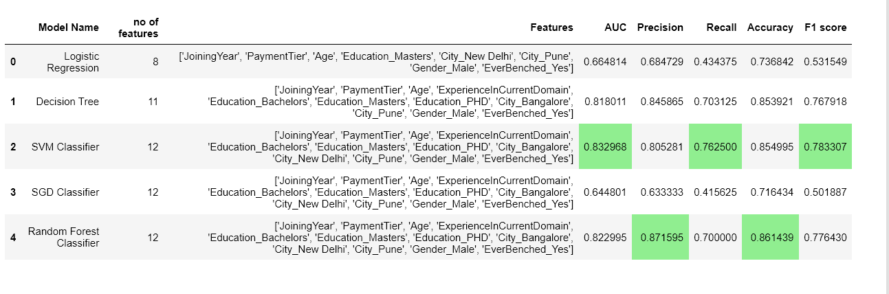
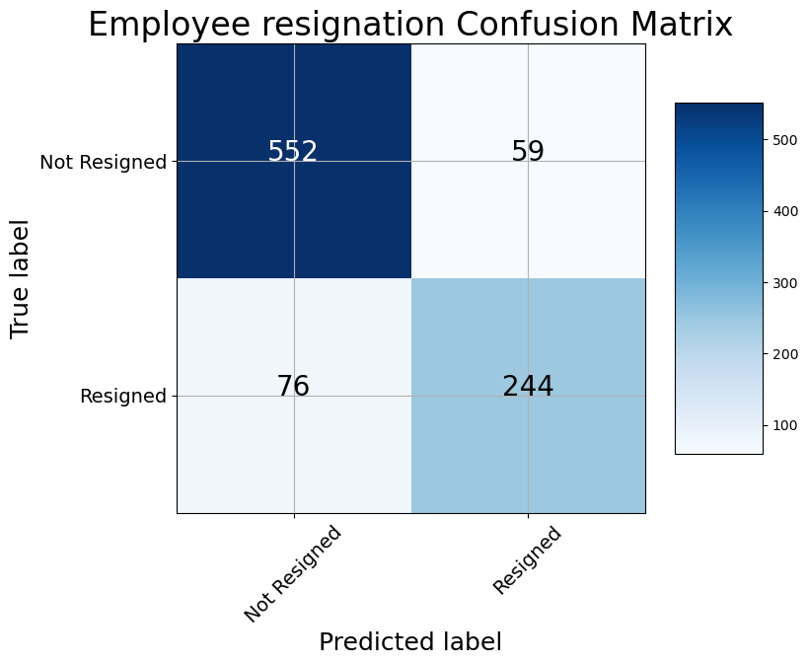
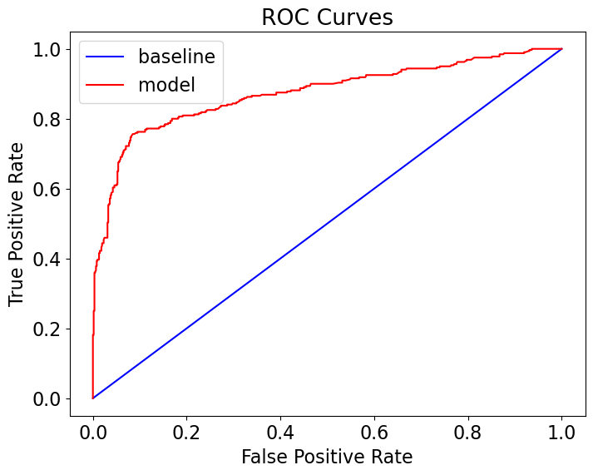
Final best model:SVM
We have selected the model based on AUC score since our data is imbalanced.
So we have selected SVM Classifier with all 12 features.
Our final model metrics are,
AUC – 0.832
Precision – 0.805
Recall – 0.7625
Accuracy – 0.8549
F1 score – 0.783

Slide 14
Thank y0u

